Slide 1
Step Function Leaps in RTL Functional Verification Powered by AI/ML Innovations

Slide 2
Presenters
Darron May
Director of AI
Product Management
Dan Yu
Chief Ai/ML
Data Scientist
Mark Carey
Product
Engineering
Karim Ameziane
Director of
Product Engineering
Mark Eslinger
Product
Engineering

Slide 3
Agenda
Unlocking the Potential of AI
Smart Verification
Smart Creation powered by GenAI
Smart Regression & Smart Debug powered by Predictive AI
Smart Analysis powered by Analytical AI
Smart Engines powered by Predictive AI
A look at The Future of AI in EDA

Slide 4
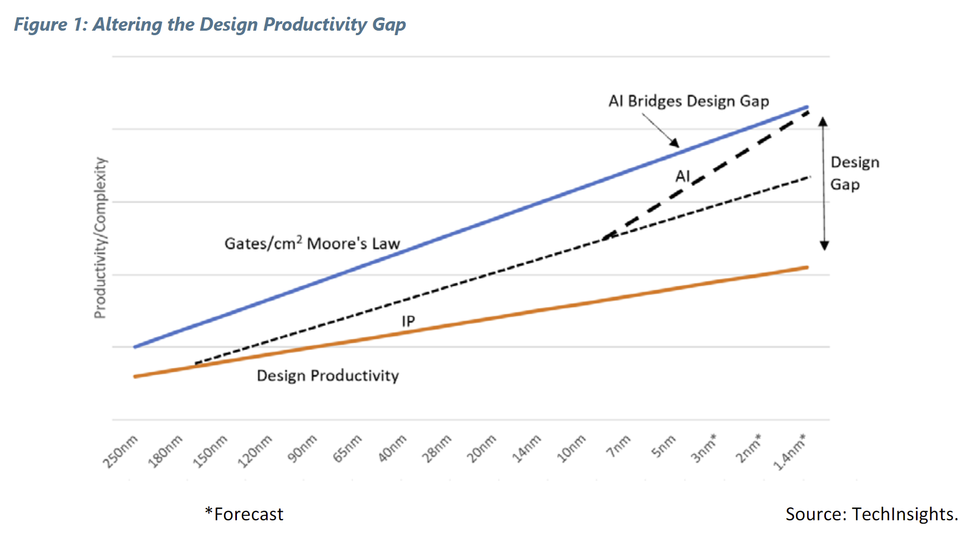
The Design Productivity Gap is a Growing Problem Bigger Designs, Smaller Teams
1
Trillion
Transistors in chiplet based processors by 2030
→
How We’ll Reach a 1 Trillion Transistor GPU - IEEE Spectrum
27.3K
Shortage of engineers in the US workforce by 2030
→
Shortage of Tech Workers - Semiconductor Industry Association (semiconductors.org)
Advanced EDA tools, new methodologies such as “shift left”, and SIP blocks (internal or 3rd party) have made it possible to close the gap somewhat … IT’S NOT ENOUGH
The capability and complexity of a system is directly proportional to the number of transistors integrated into it

Slide 5
Siemens Three Track Approach Strength of the Larger Organization
Earlier Adopter Customers
Access to Real Project Datasets
Introducing Early Requirements
Partners
IC and EDA Division Experts
Siemens EDAi Central Group
Functional Verification AI & Data Science Team
Siemens Digital Industries
1400+ AI Experts & 3700+ AI Patents
Creating Verification Knowledge Graph
Research on EDA AI Approaches
Siemens Technology

Slide 6
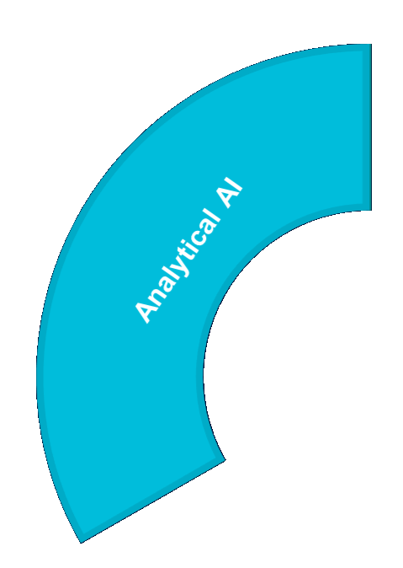
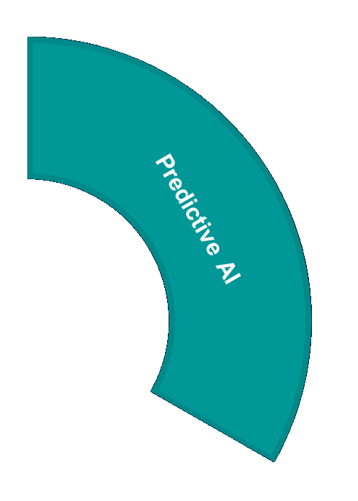
Focusing the Potential of AI for Verification Productivity The Different AI Approaches and Product/Feature Targets
Analyze
Optimize
Identification of key data insights not practical with traditional methods
Domain specific predictive models to reduce computational requirements and accelerate decision making
FASTER ENGINES
Complimenting heuristics and graph analytics in core engines & tools
Solutions
FASTER ENGINEERS
Enabling new creation, analysis, assistant and debug capabilities
Generate
Accelerate design creation, system optimization, and model abstraction
FOCUSED WORKLOADS
Predictive technologies to
stream-line & accelerate
verification

Slide 7
AI Assisted Productivity Accelerating Every Step in Design and Verification
Smart-Network
Smart-Wallet
Smart-Bulb
Smart-Plug
Smart-Phone
Create
Smart-Blind
Smart-Watch
Smart-Display
Smart-Home
Smart-Meter
Smart-TV
Debug
Execute
Smart-Wearables
Smart-Speaker
Smart-Camera
Smart-Car
Smart-Security
Smart-Grid
Smart-Card
Analyze
Smart-Lock
Smart-Doorbell
Smart-Thermostat
Smart-Sensor
Smart-Glasses
Smart-Hub
Smart-Battery
Smart-Bike
Time To Market

Slide 8
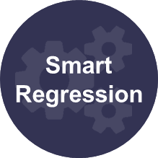
Smart Verification Accelerating Functional Verification
Create
Smart
Debug
Execute
Verification
Analyze

Slide 9
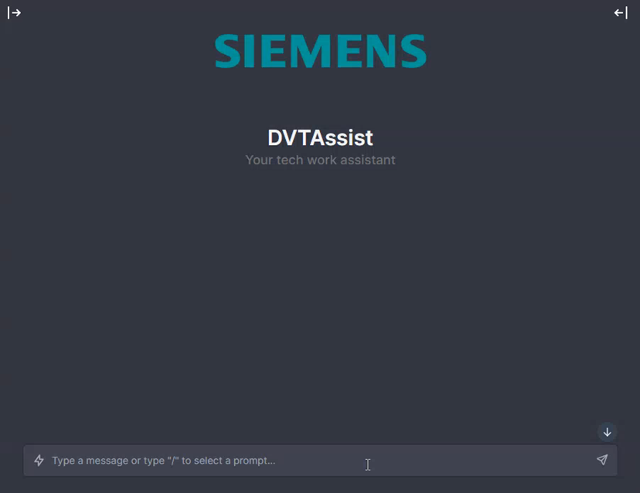
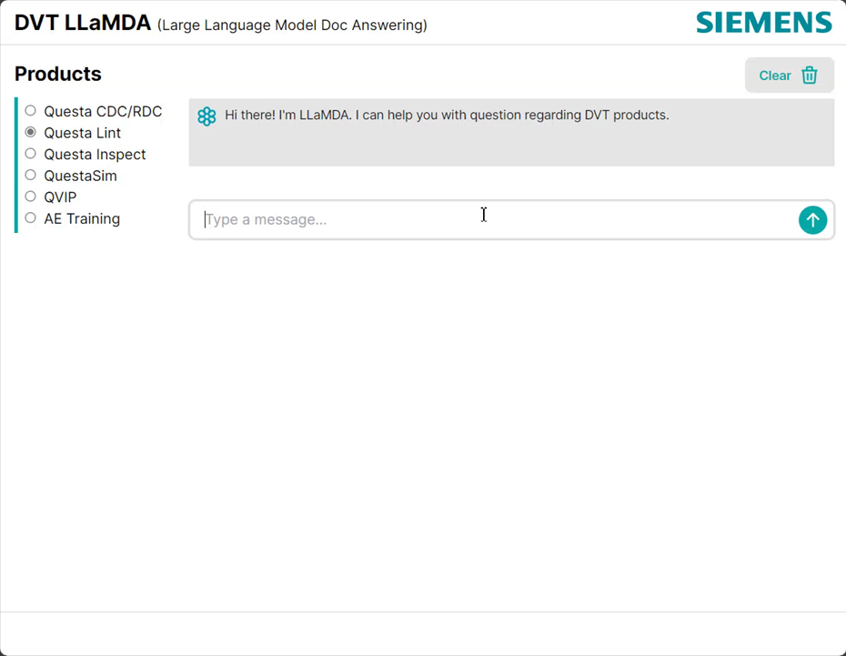
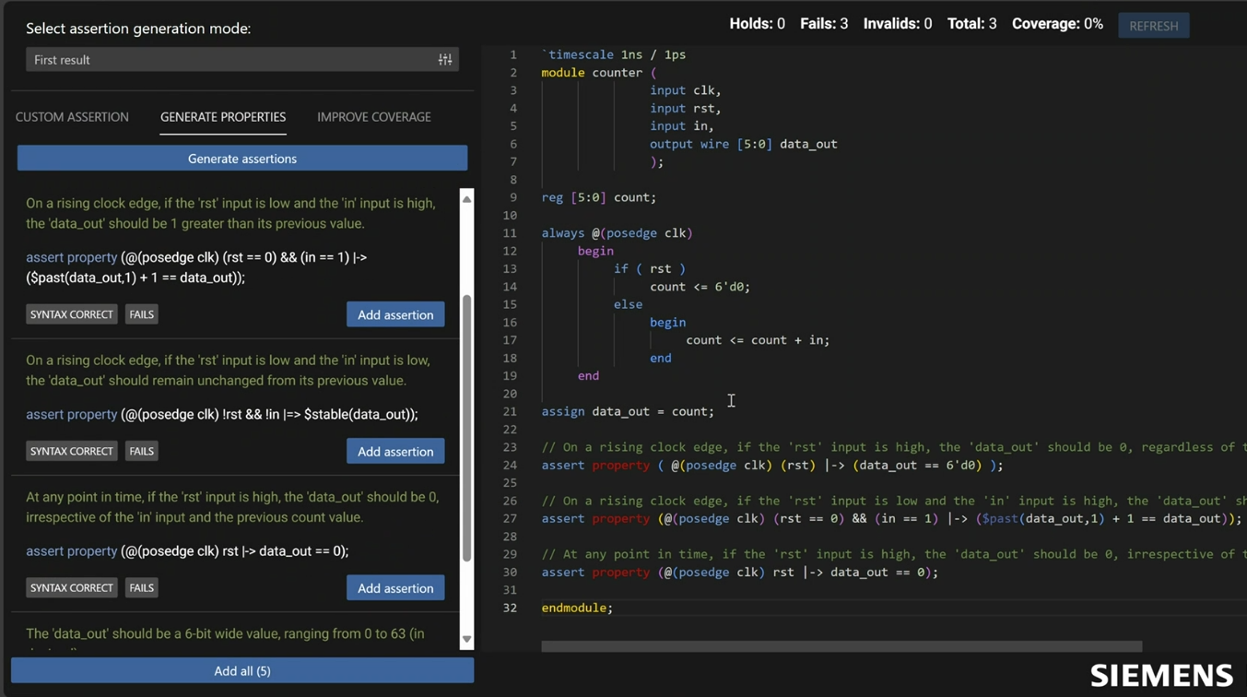
Solving Creation Challenges with Smart Creation How Can AI/ML assist me to ...
FASTER ENGINEERS
… learn languages faster?
… get answers on how to use tool
features faster?
… accelerate the generation of assertion code ?
… create Testplans faster?
Code
Generation
Finetuned LLM trained on niche language knowledge to generate RTL, UVM and PSS code
Documentation
Exploration
Natural language-based service portal with detailed knowledge of all products to accelerate tool usage
Property
Assist
Finetuned LLM enables the automatic generation of SVA to accelerate assertion-based methodologies
Testplan
Generation
LLM translation between design specification sources and Testplan to accelerate Plan Driven Verification

Slide 10
Smart Creation Generative AI Platform and Technologies
Siemens EDAi Platform
Generative AI Delivery

Slide 11
Smart Creation Applying Generative AI to Assertion Based Methodologies
Property Assist Overview
Customer Benefits

Slide 12
Smart Creation Generative AI Faster Engineers with Property Assist Demo

Slide 13
Smart Verification Accelerating Regressions
Smart
Verification

Slide 14
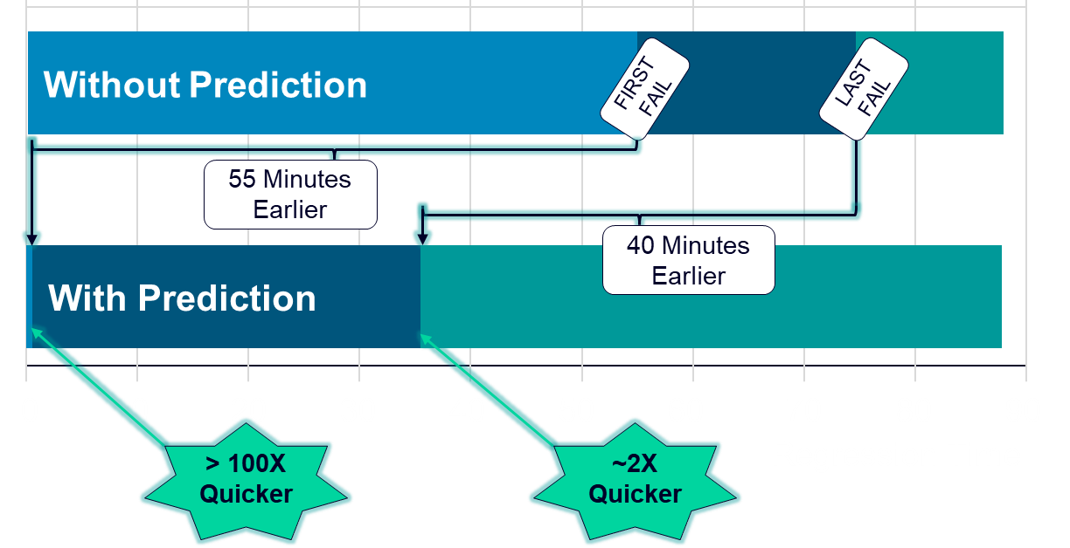
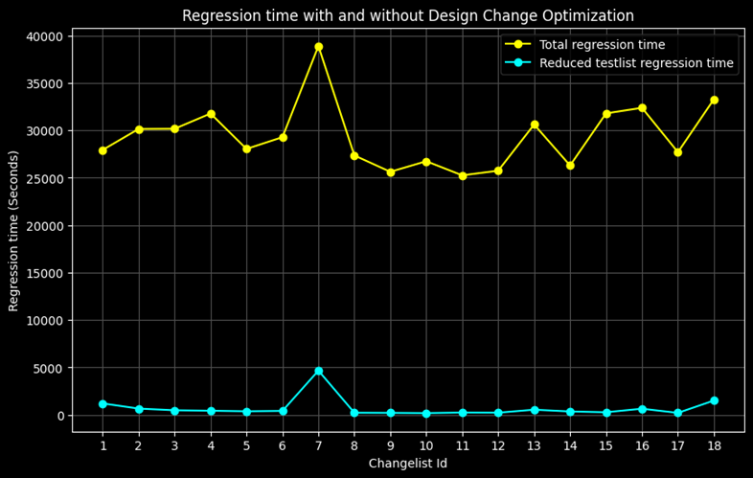
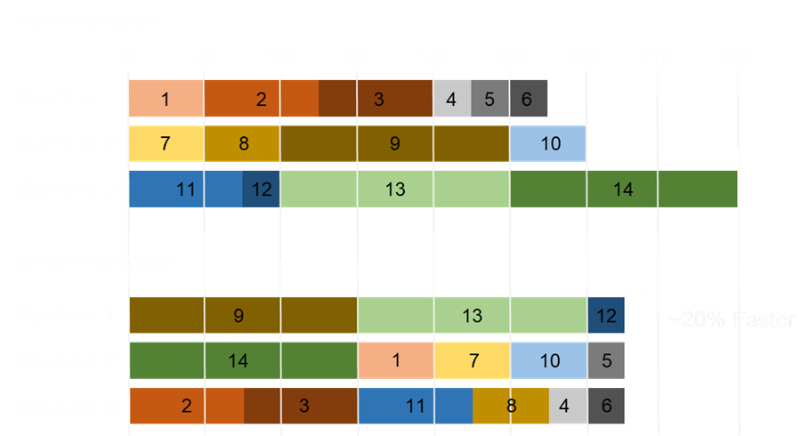
Solving Regression Challenges with Smart Regression How Can AI/ML ...
FOCUSED WORKLOADS
… ensure failures
occur as soon as
possible?
… accelerate verification when
testing changes?
… complete a regression in the minimum amount
of time?
Failure
Prediction
Select the tests predicted to fail so they can be run early in the regression to speed time to failure
Smoke-test
Prediction
Select a sub-set of regression tests affected by design change to accelerate verification of changes
Schedule
Prediction
Predict computing demand of regression to optimize resource allocation, with cost or time objectives

Slide 15
Smart Verification Accelerate Debug Turn-around
Smart
Verification

Slide 16
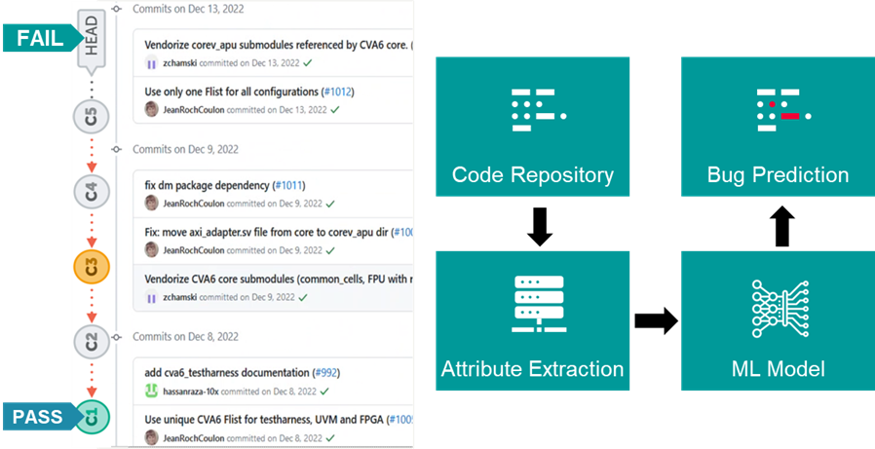
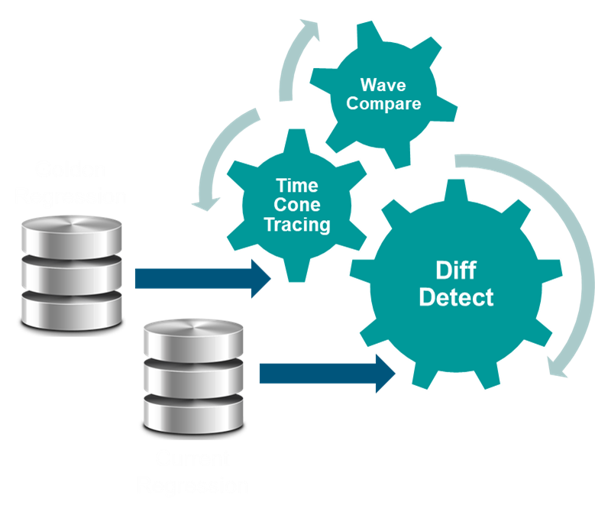
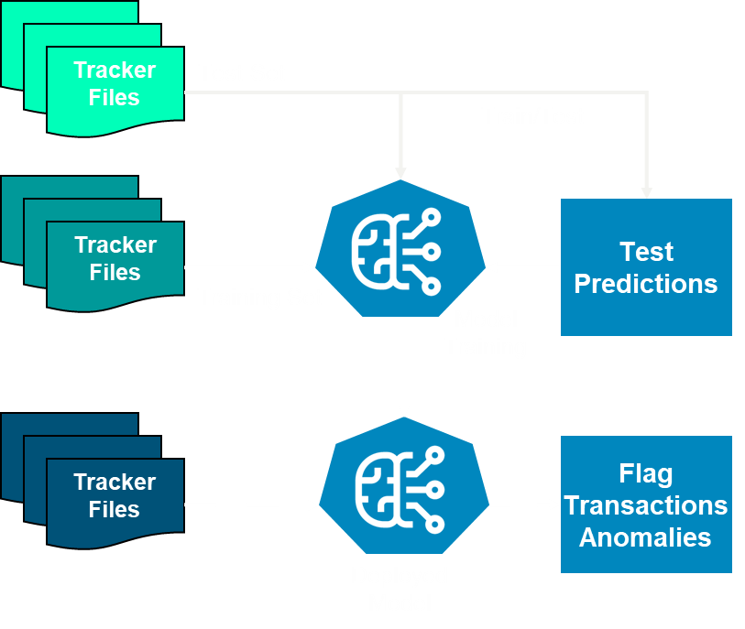
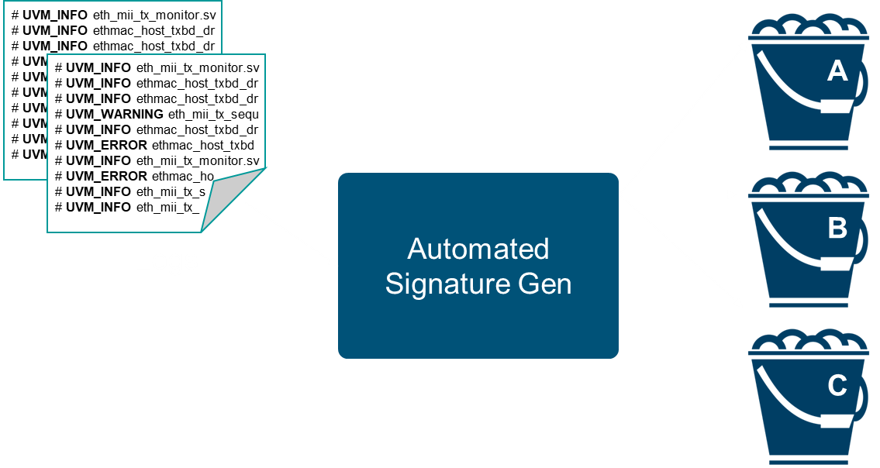
Solving Debug Challenges with Smart Debug How Can AI/ML ...
FASTER ENGINEERS
… quickly find the commit that caused my failure?
… accelerate and automate failure
bucketing?
… pinpoint the location or signal causing failure?
… accelerate transaction debug
of protocols ?
Bad Commit
Prediction
Predict the commit most likely responsible for failure to accelerate the location of tests to jumpstart debug
Signature
Prediction
Automatic failure signature bucketing to reduce TAT and start root cause analysis sooner
Root Cause
Prediction
Automatic location of scopes & signals most likely to cause failure to reduce TAT and start debug sooner
Protocol
Analysis
Automate transaction detection of protocol anomalies accelerating Protocol Compliance

Slide 17
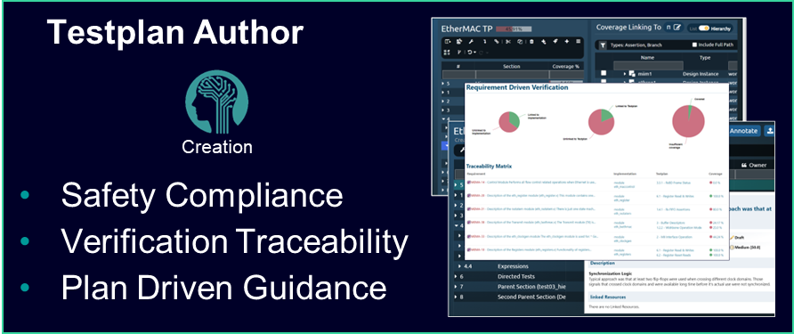
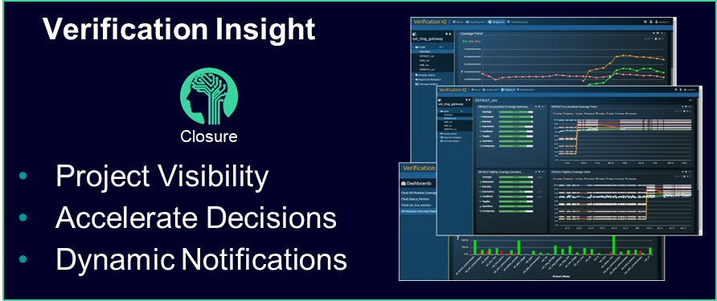
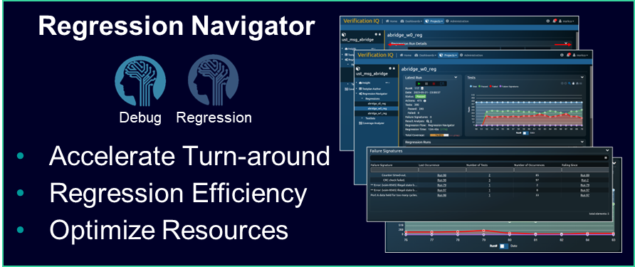
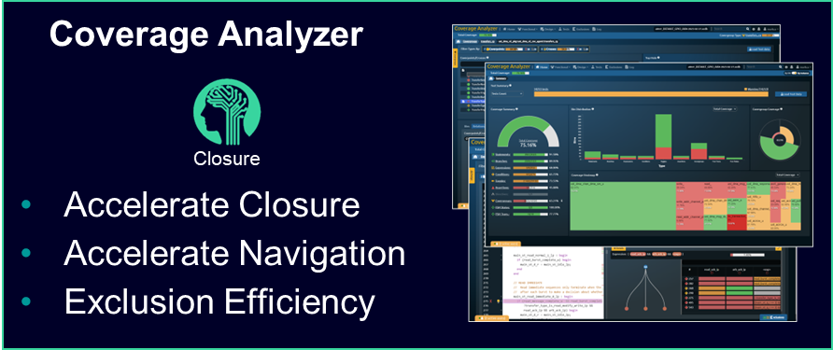
Verification IQ Maximizes Productivity Data-Driven Verification Management Solution
Planning
Manage
Regression
Debug
Coverage
Collaboration
Traceability
Analytics AI/ML
Data
Driven
Change

Slide 18
Optimize Regression Cycles & Accelerate Turn-Around Times VIQ Regression Navigator Provides Intelligent Regression & Debug
Smart Debug
AI/ML Assisted
Root Cause Analysis
Run Management
Automated, Accelerated, & Efficient Regression
Collaborative Regressions
Smart Regression
AI/ML Assisted Regression Optimization
Data Mining
Improve Decision-making with Historical Trends
Interoperability
Efficiency across Domains
Rules Based Triage
Automated Failure Analysis

Slide 19
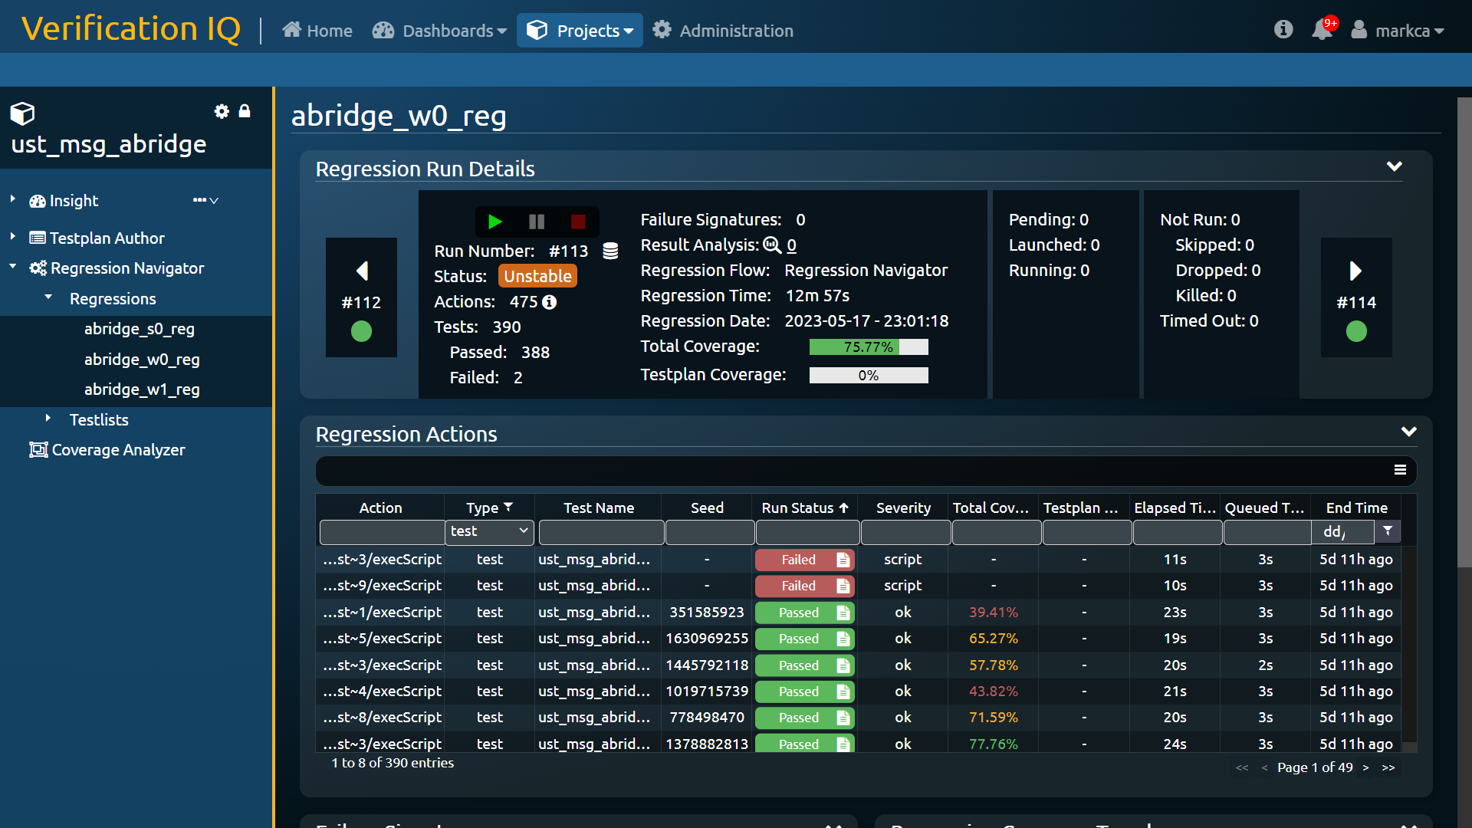
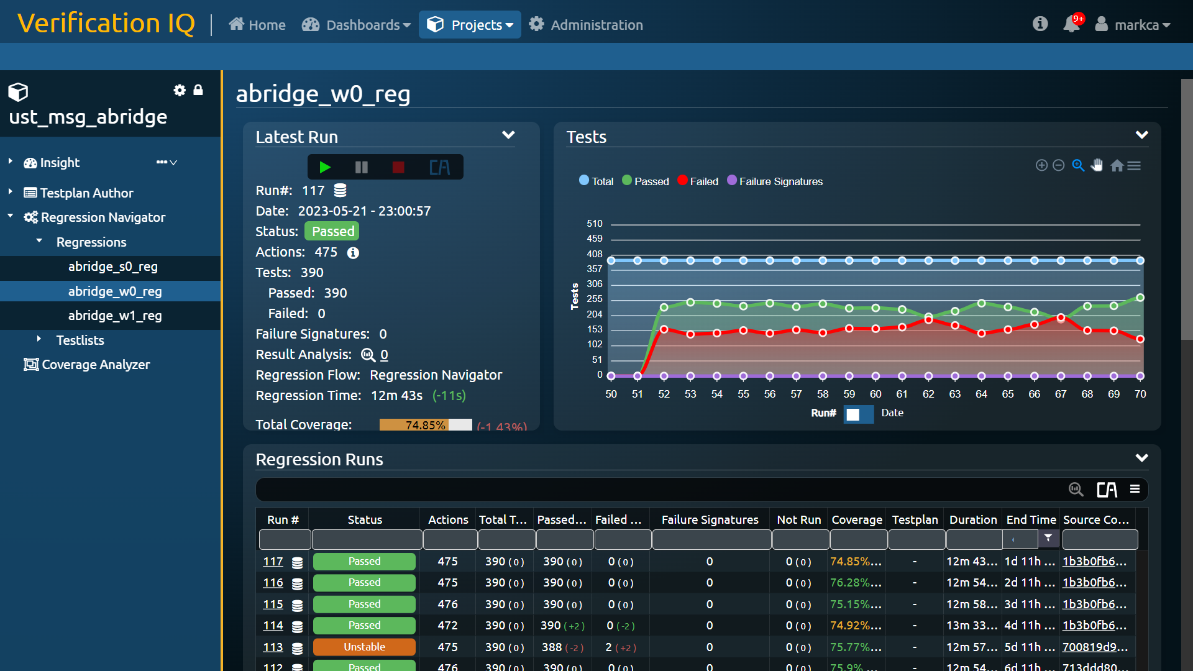
Verification IQ Regression Navigator Accelerating Turn-around Times & Efficent Resource Management
Regression History
Results Trend
Regression Summary
Failure Grouping
Zoom In

Slide 20
VIQ Regression Navigator Applying AI Prediction with Smart Regression and Smart Debug
Arch Diagram

Slide 21
Smart Debug & Regression Predictive AI Faster Engineers & Fewer Workloads with Regression Navigator Demo

Slide 22
Smart Verification Accelerate Verification Analysis
Smart
Verification

Slide 23
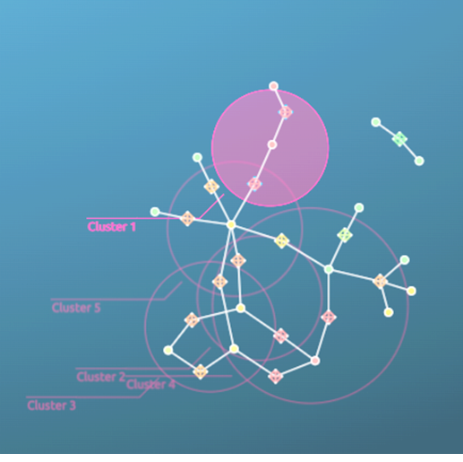
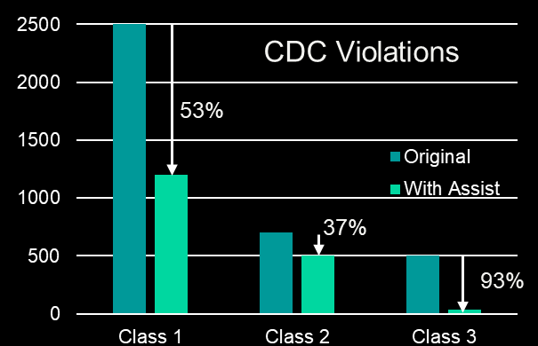
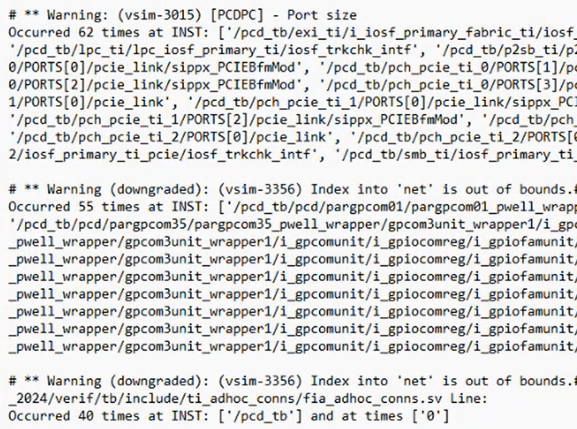
Solving Analysis Challenges with Smart Analysis How Can AI/ML ...
FASTER ENGINEERS
… accelerate expression pattern
closure?
… accelerate
cross hole coverage
closure?
… group common crossing issues &
configure tool?
… accelerate the understanding
of log output ?
Pattern
Analysis
Automatically extract common expressions to accelerate stimulus gen or pattern exclusion
Cross Hole
Analysis
Automatically extract the worst cross coverage holes to accelerate generation of new stimulus to cover holes
CDC/RDC
Assist
Automate message clustering to reduce noise, generate constraints & corrective suggestions
Log Message
Clustering
Automate message clustering to reduce noise, and generate easier to understand output

Slide 24
Accelerate Coverage Closure VIQ Coverage Analyzer Provides Intelligent Closure
Pattern Analysis
Smart Closure, Expression Analysis
Unified Coverage
Efficient Transition of existing methodology
Collaborative
Coverage Closure
Hole Analysis
Smart Closure, Cross Hole Analysis
Analytical
Navigation & Visualization
Accelerate Understanding and Closure
Team-base Communication
Accelerate Closure with Enhanced Team Communication
Exclusion Management
Accelerate Exclusion Application and Auditing

Slide 25
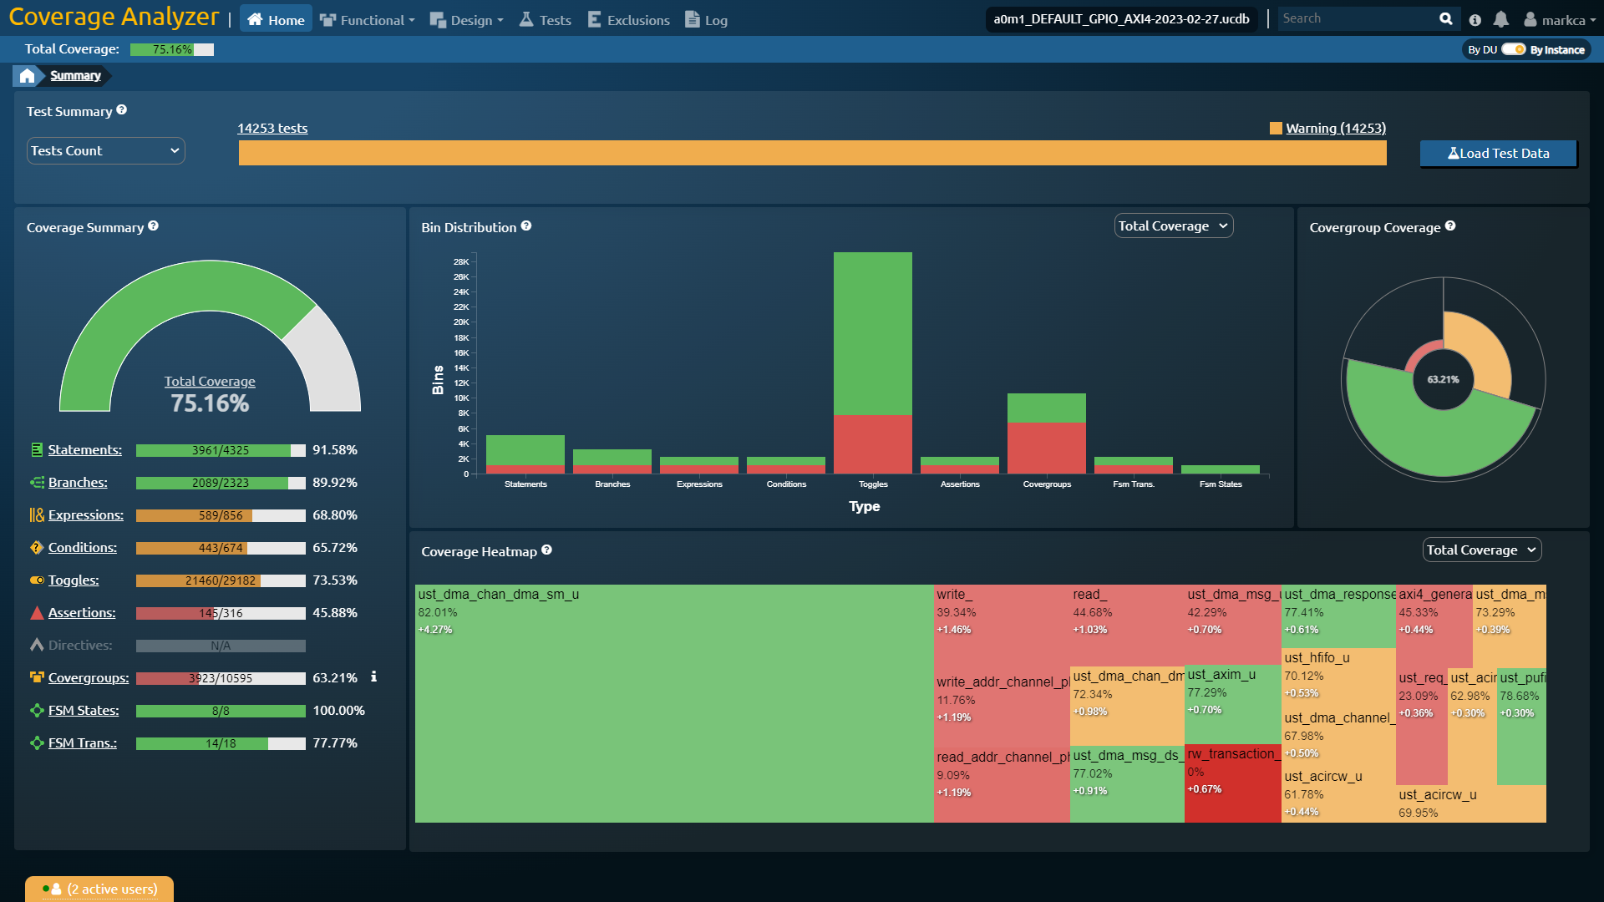
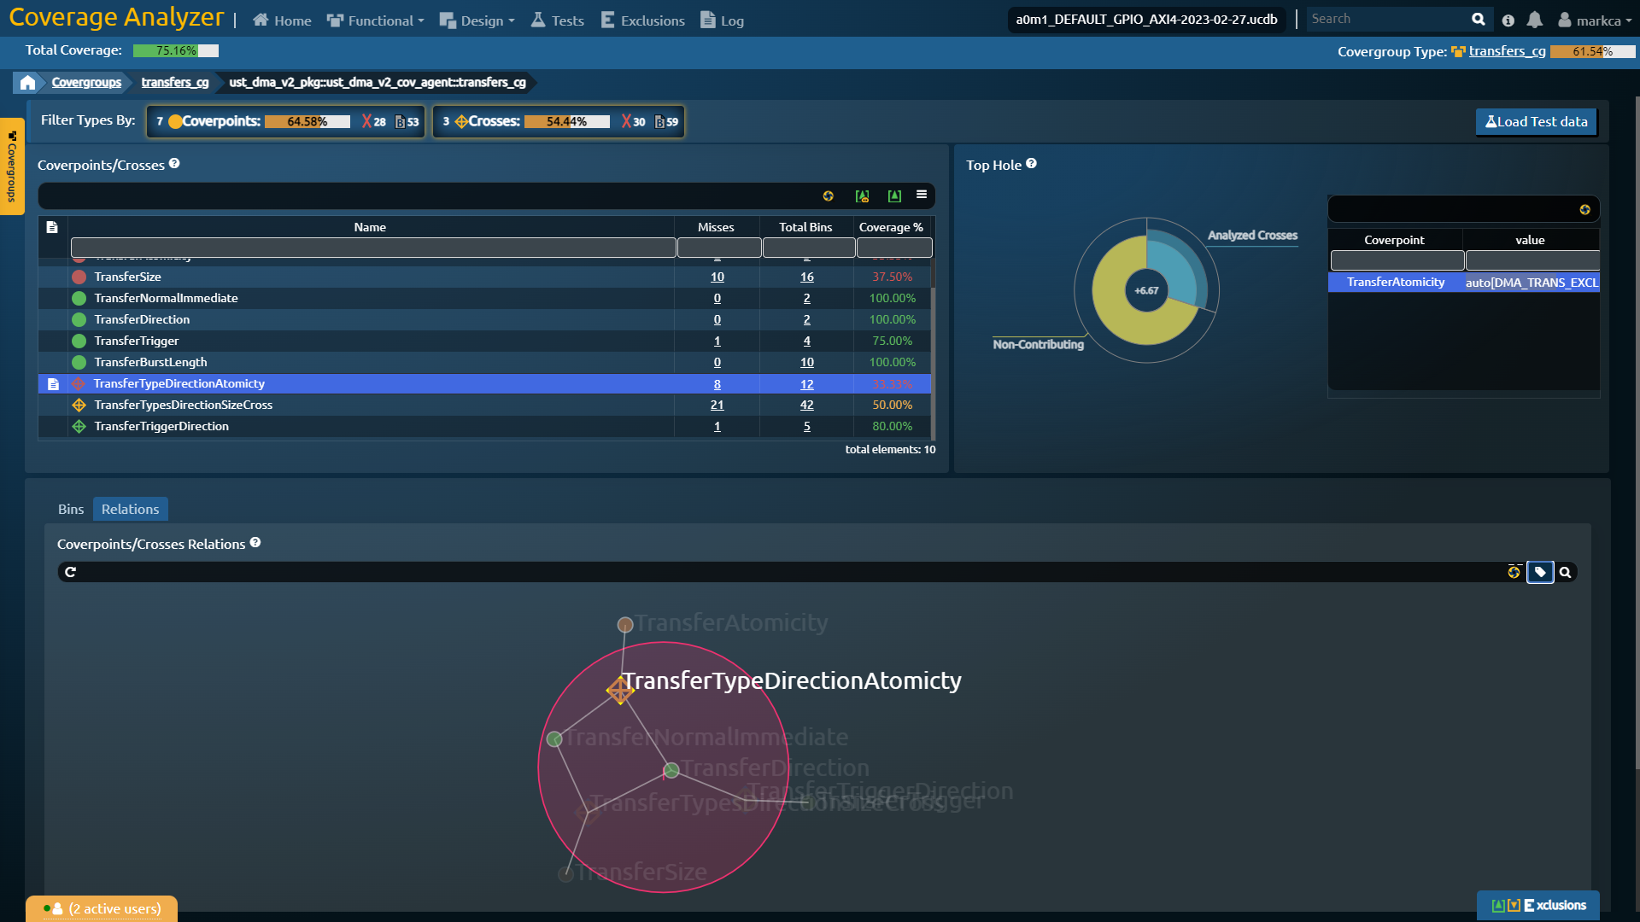
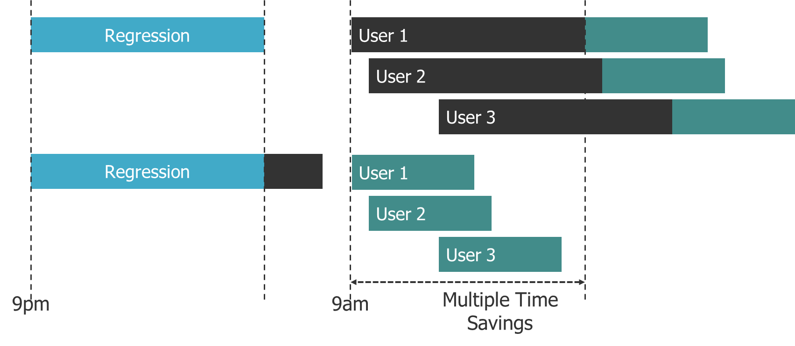
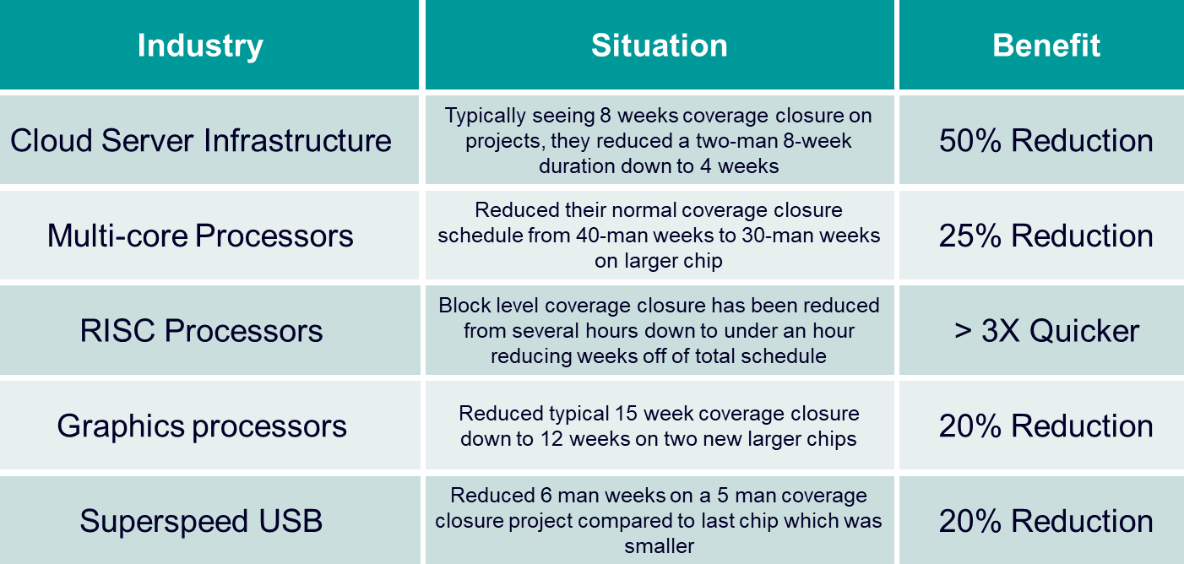
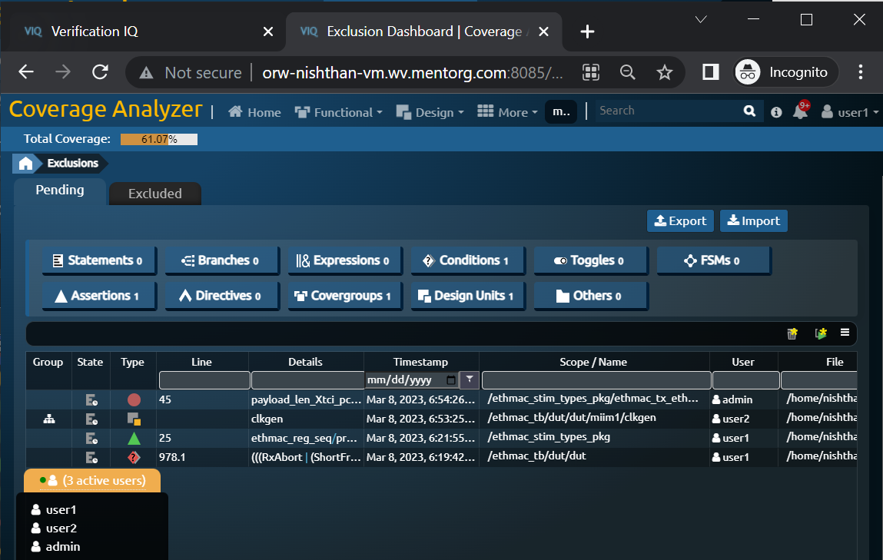
Verification IQ Coverage Analyzer Collaborative Data-Driven Verification Closure
Traditional
Coverage Analyzer
Heatmap
Distribution Graph
Aster Plot
Network Graph
Expression Tree
Team-based Exclusions

Slide 26
Smart Analysis Analytical AI Faster Engineers with Coverage Analyzer Demo

Slide 27
Smart Verification Accelerate Verification Engines
Smart
Verification

Slide 28
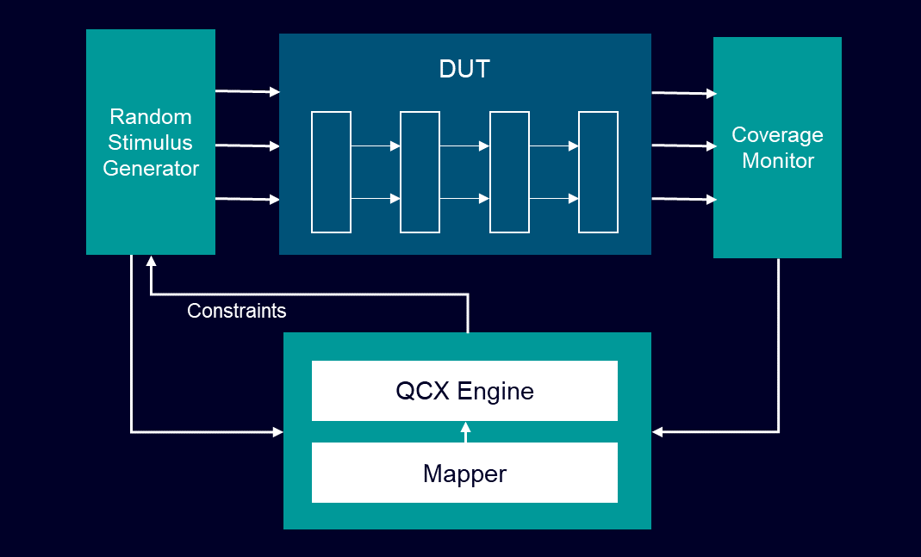
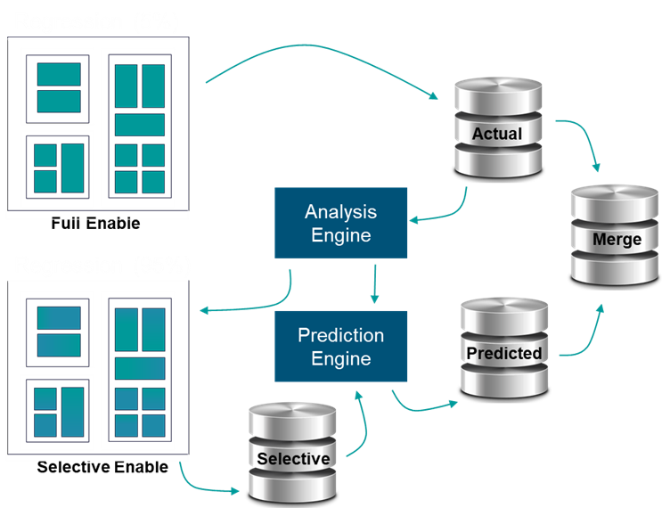
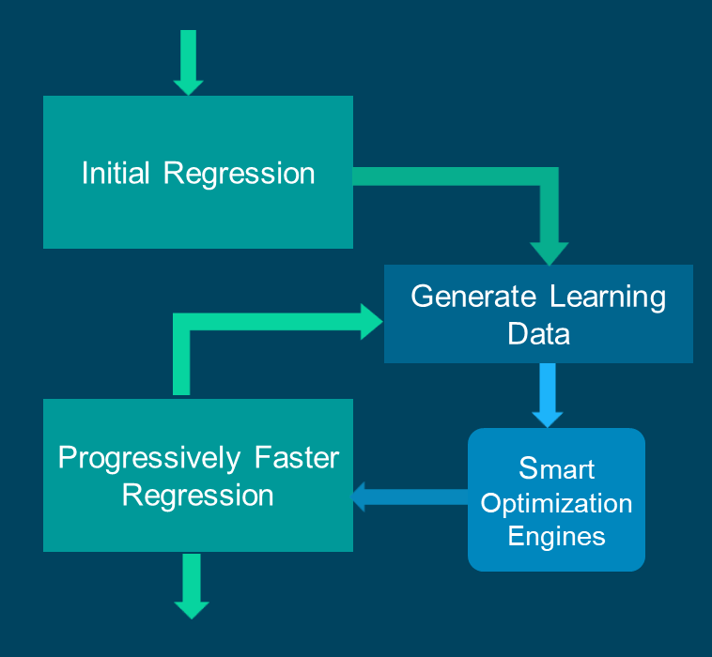
Accelerate Engines with Smart Engines How Can AI/ML ...
FASTER ENGINES
… guide stimulus
to my unhit coverage bins?
… ensure coverage overhead is kept minimal?
… ensure optimal
speed of my
simulations?
Coverage
Acceleration
Predict constraints to guide stimulus to specific coverage targets to accelerate coverage closure
Coverage
Optimization
Selectivity enable coverage within design to reduce overhead and predict total coverage by data mining
Progressive Performance
Determine optimal tool settings and opts based on history with self-tuning to accelerate regression

Slide 29
Smart Engines Applying Predictive AI to our Engines
QCX Overview

Slide 30
Smart Engines Applying Predictive AI to our Engines
Customer Benefits

Slide 31
Smart Engines Predictive AI Faster Engines with QCX Demo

Slide 32
AI Maximising Verification Productivity Faster Engines, Faster Engineers and Fewer Workloads
RTL/UVM/PSS Generation
Documentation Exploration
Property Assist
Testplan Generation
Bad Commit Prediction
Signature Prediction
Root Cause Prediction
Protocol Analysis
Smart
Failure Prediction
Smoke-test Prediction
Schedule Prediction
Verification
Coverage Acceleration
Progressive Performance
Pattern Analysis
Coverage Optimization
Cross Hole Analysis
CDC/RDC Assist
Log Clustering
Analytical
AI
Predictive
AI
Generative
AI

Slide 33
Smart Verification Unleashing the Potential of AI Within Functional Verification Projects In-flight across Multiple Products

Slide 34
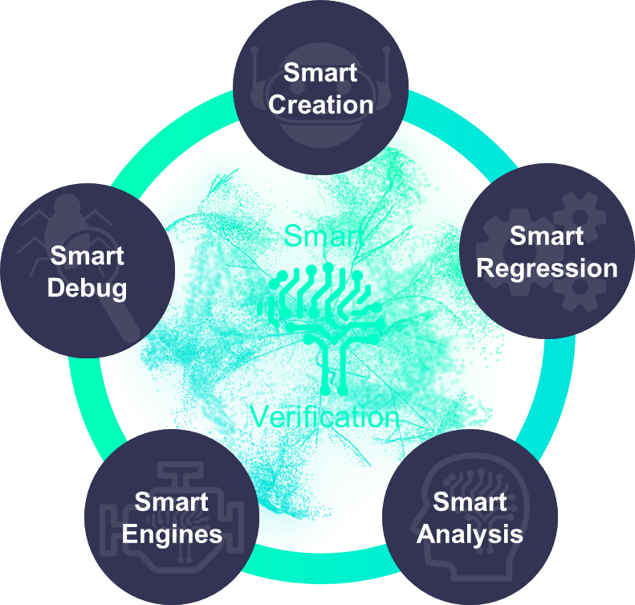
Siemens EDA Smart Verification Functional Verification powered by AI
Faster Engines
Faster Engineers
Focused Workloads

Slide 35
A look at The Future Landscape is moving fast
LLM Landscape for EDA

Slide 36
A look at The Future Landscape is moving fast
Legal

Slide 37
A look at The Future Landscape is moving fast
What comes next

Slide 38
Contact
Published by Siemens EDA
Darron May
Director of AI Product Management
E-mail darron.may@siemens.com

Slide 39
Disclaimer
© Siemens 2025
Subject to changes and errors. The information given in this document only contains general descriptions and/or performance features which may not always specifically reflect those described, or which may undergo modification in the course of further development of the products. The requested performance features are binding only when they are expressly agreed upon in the concluded contract.
All product designations may be trademarks or other rights of Siemens AG, its affiliated companies or other companies whose use by third parties for their own purposes could violate the rights of the respective owner.

